Slide 1

To find out how long the patients are going to stay in the hospital after coming out from ICU
Team Members:
Shiny Manasseh Chilakabathini
Sanisha Reddy Kolanu
Namrata Alapati

Slide 2
Abstract:
This project discusses about the use of MIMIC III data to identify patients that require extra medical attention depending on the length of stay post ICU.
This project uses SQL server management system to clean and process data suitable for weka software.
Weka software is used to perform feature selection, run classification models and to perform model evaluation.
Performance of different classification models are compared based on their evaluation metrics to identify the suitable one.

Slide 3

Problem Statement:
To develop a predictive model that accurately forecasts whether a patient's length of stay after Intensive Care Unit (ICU) treatment will exceed more than a week.

Slide 4
Background
The transition of patients from Intensive Care Unit to general ward and further to dischargement is pivotal.
Understanding and prediction of the length of hospital stay post ICU discharge is vital for resource management.
Accurate predictions optimize bed and staff allocation.
Proactive planning ensures timely and tailored patient care.
Identifying patients who needs extra attention or interventions.

Slide 5
Dataset
From the extensive MIMIC-III datasets, we've strategically chosen subsets, aligning with our project's focus on model complexity and performance.
Admissions, CPTevents , Diagnoses-ICD, ICU_stays, Patients and Procedure_id have been selected and included.
Length of stay will be our target variable which defines how long a patient stays after their discharge from ICU.

Slide 6
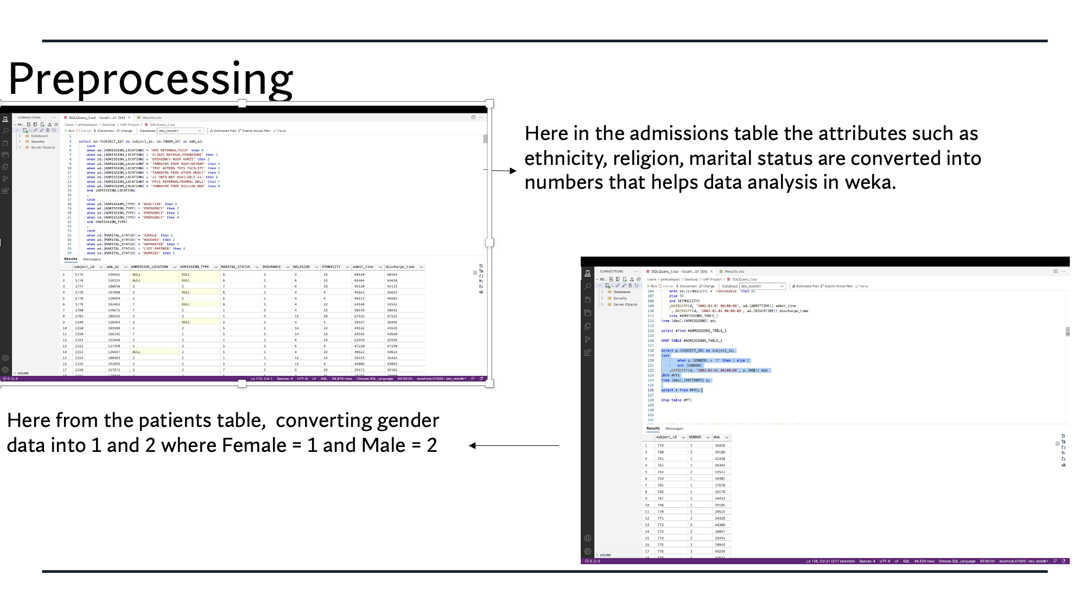

Slide 7
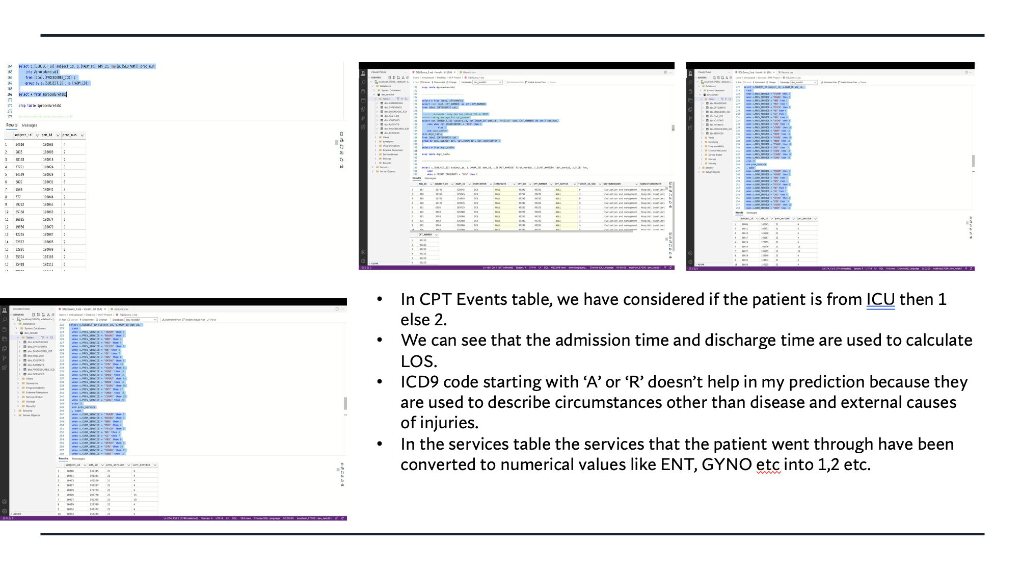

Slide 8
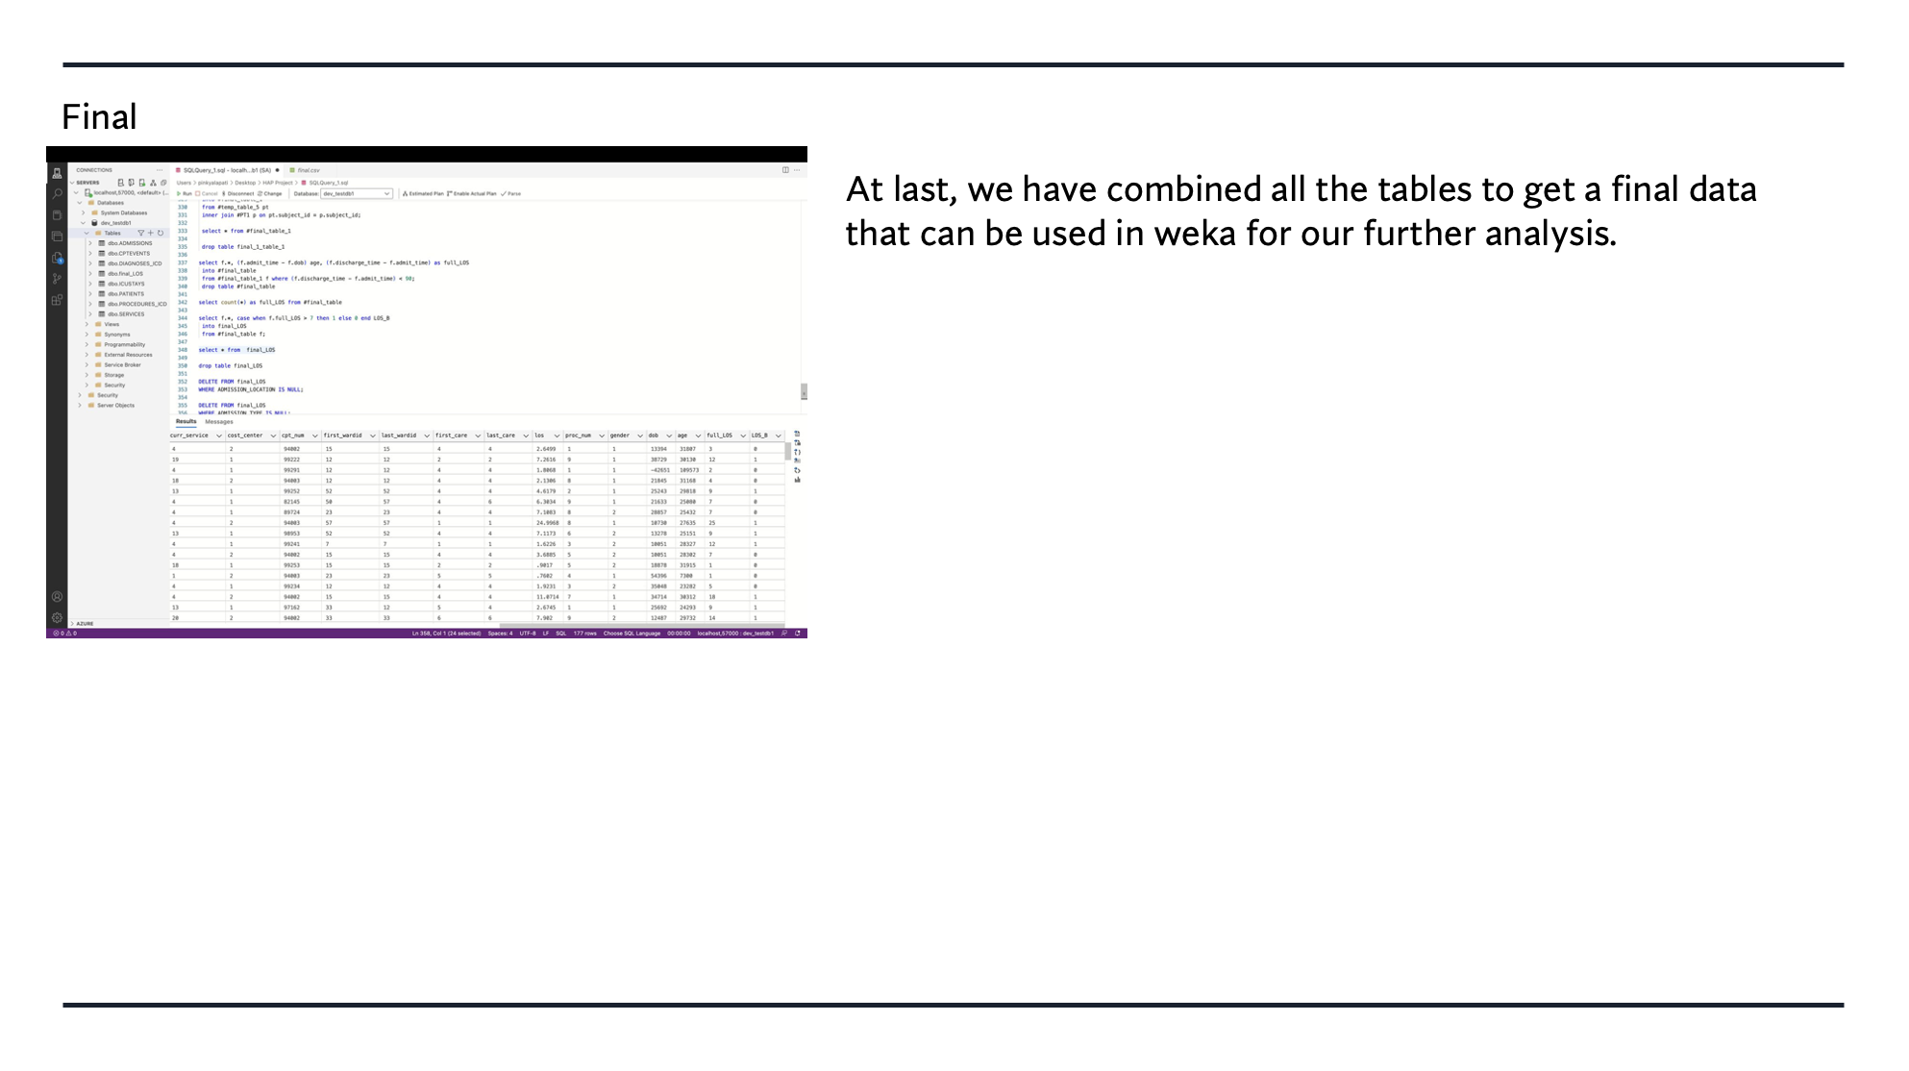

Slide 9
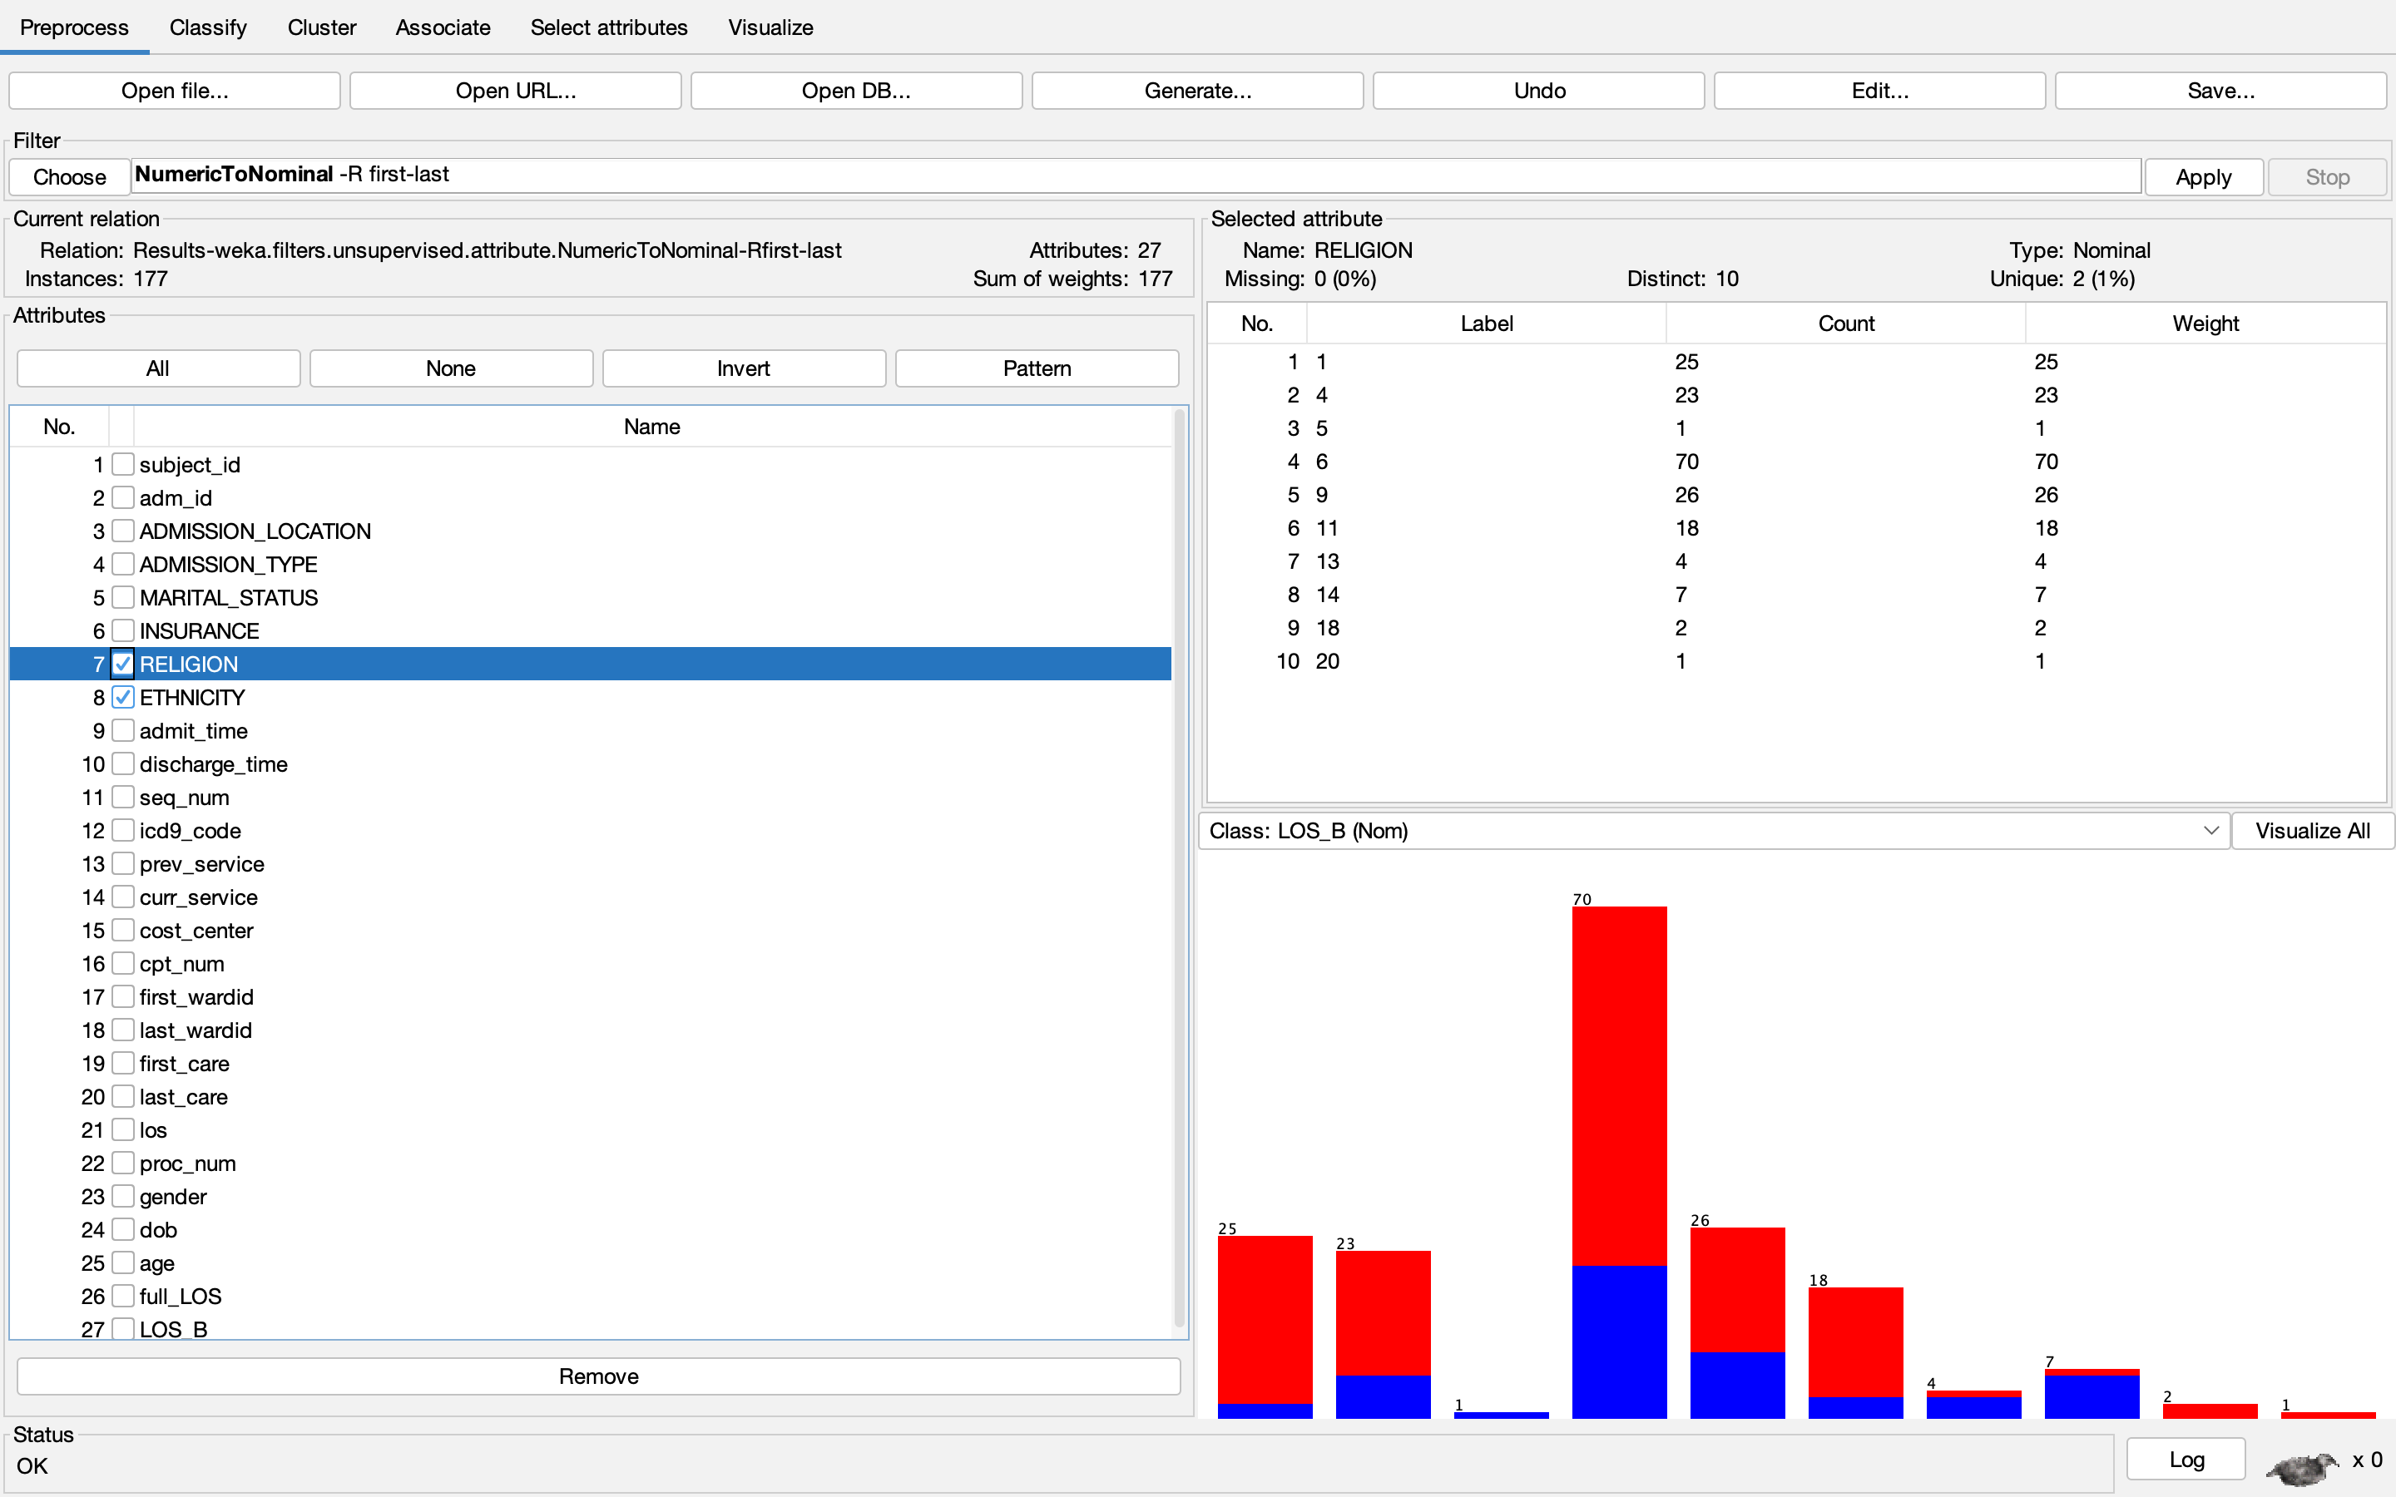
Weka
Well formatted data from data processing steps is fed into Weka application for further pre-processing.
Attributes are converted into nominal data type for further operations.

Slide 10
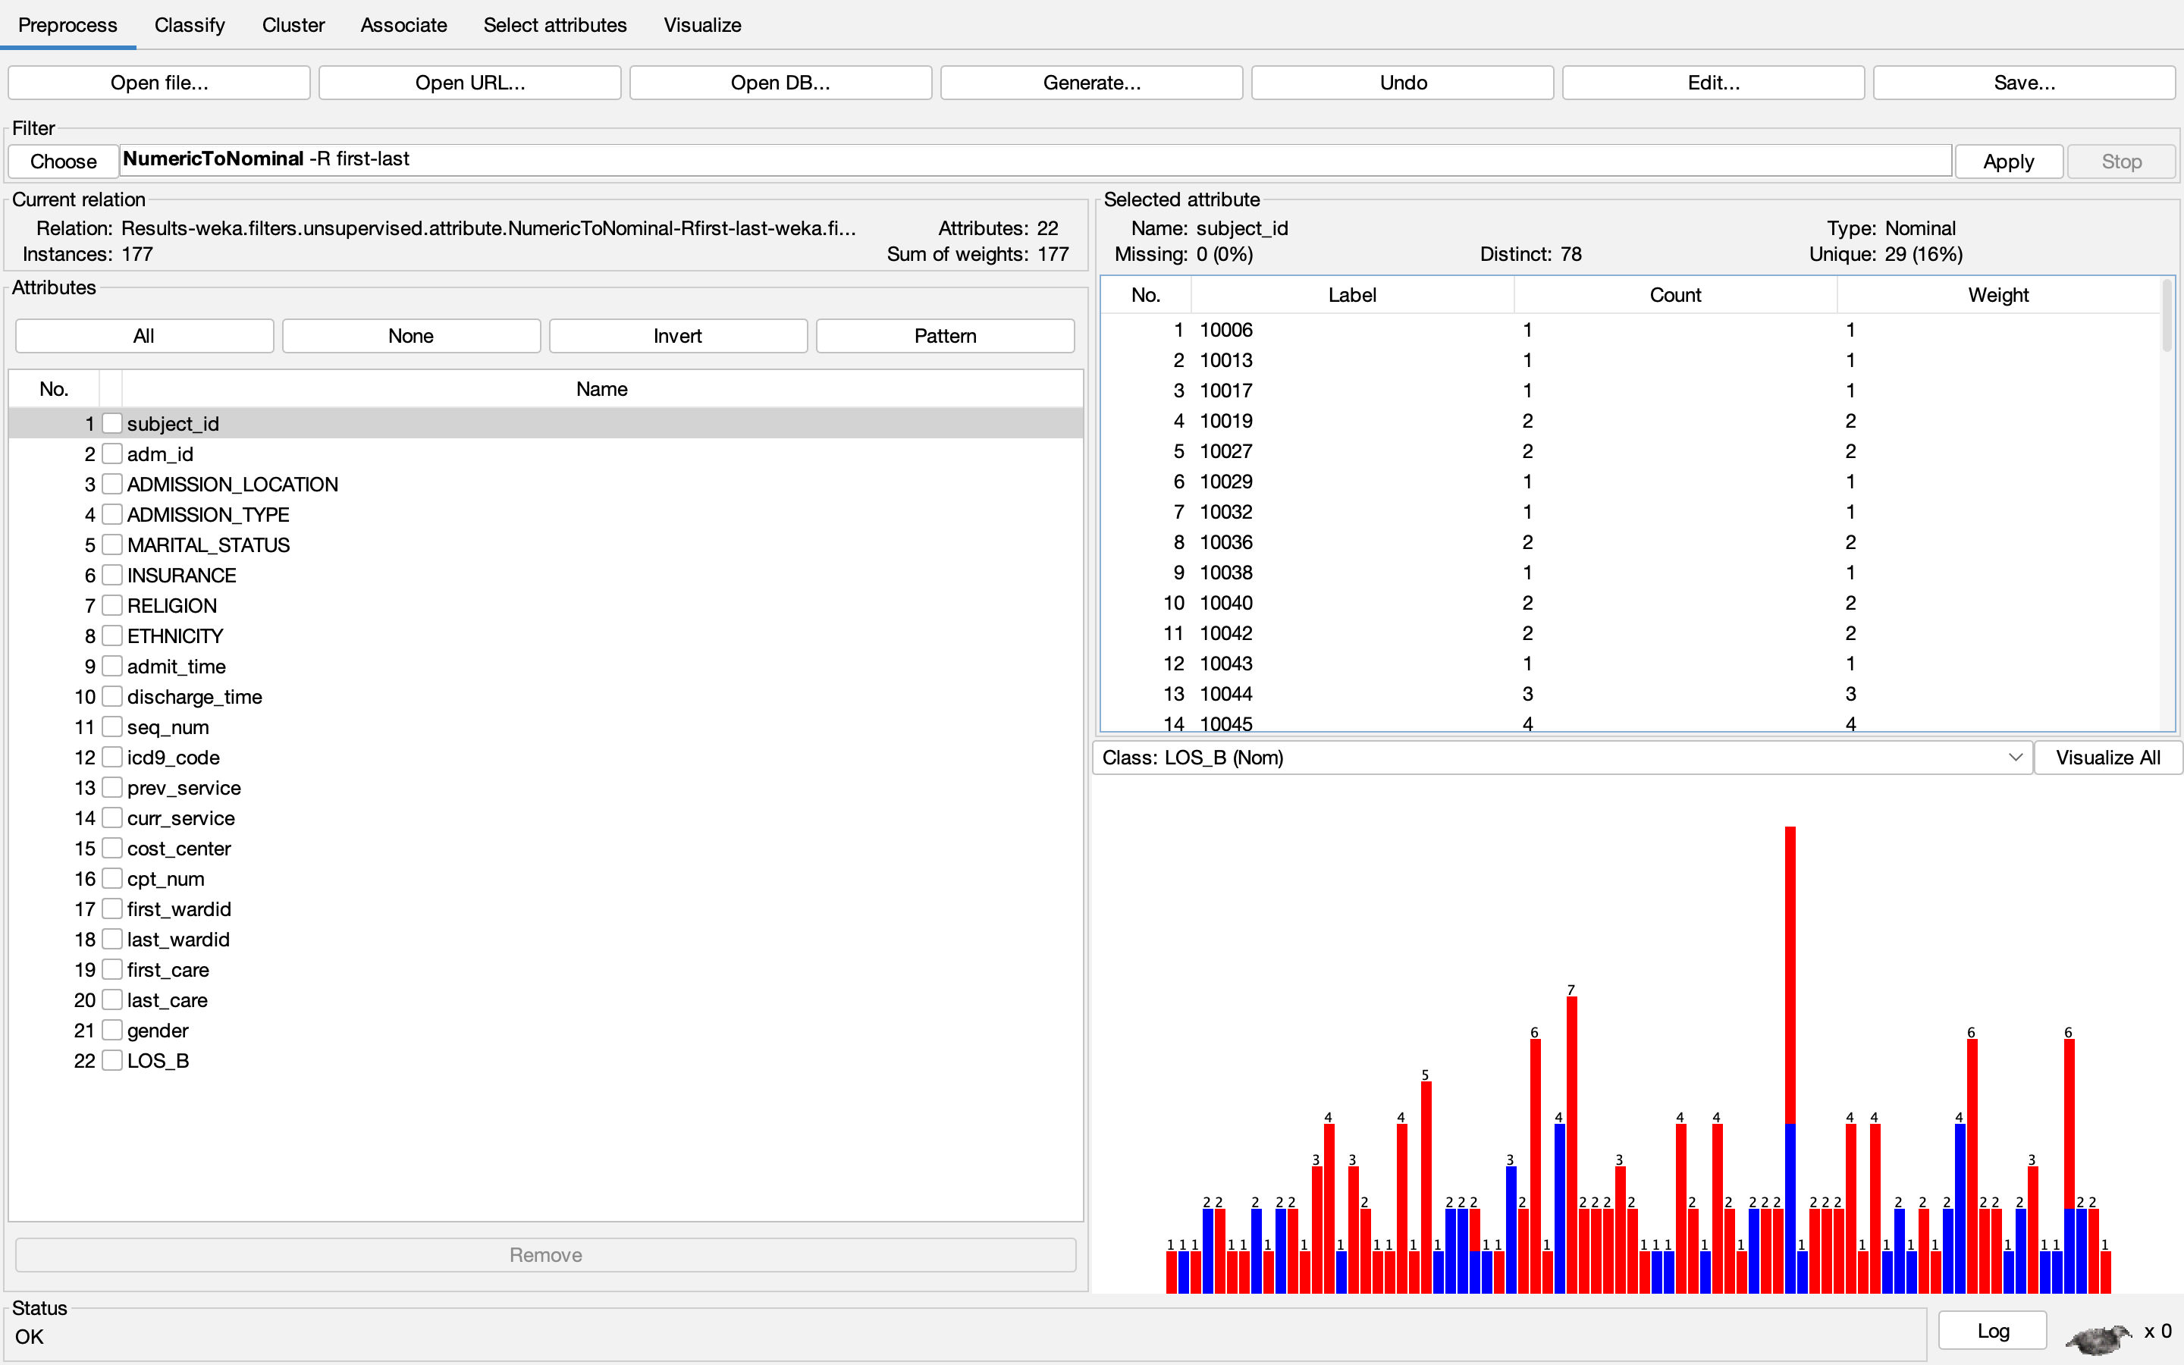
We have removed unwanted attributes like subject_id, adm_id, dob, los, and full_los.
The final number of attributes is reduced to 22.

Slide 11
Models Used:
Bayes Network Classifier.
Decision Tree Classifier
Split Ratio and Validation Methods:
60 – 40 Split (60% Training and 40 % Testing)
10-Fold Cross Validation
Logistic Regression Classifier
Naïve Bayes Classifier

Slide 12
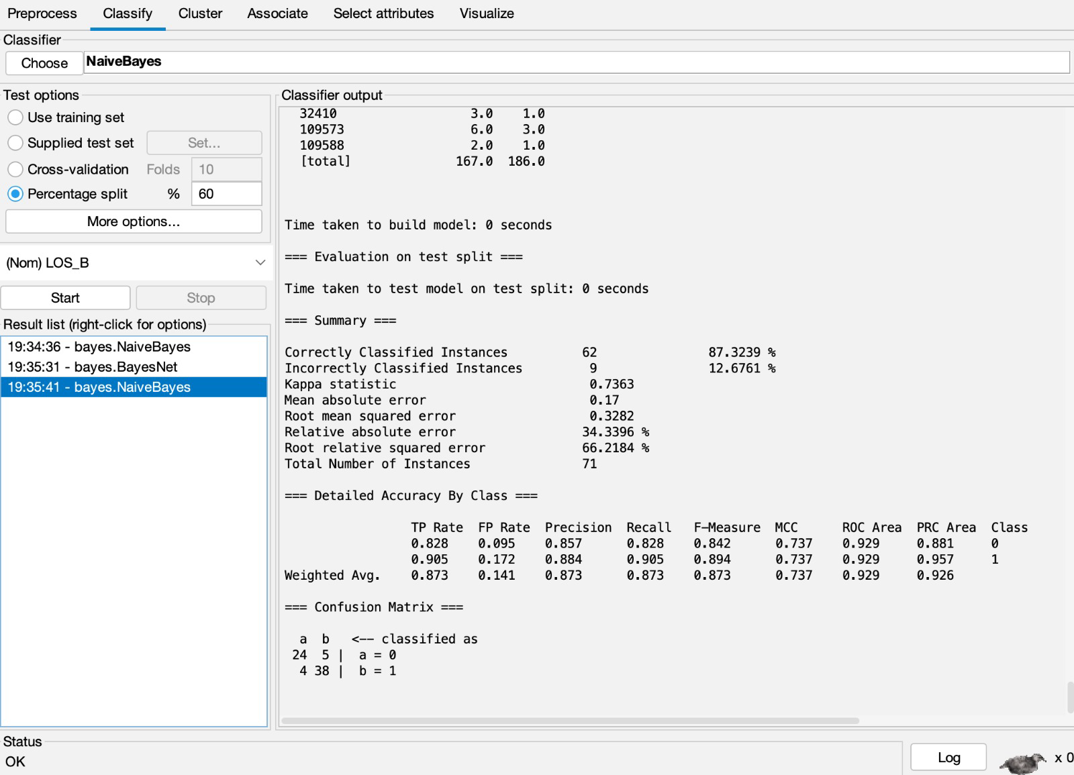
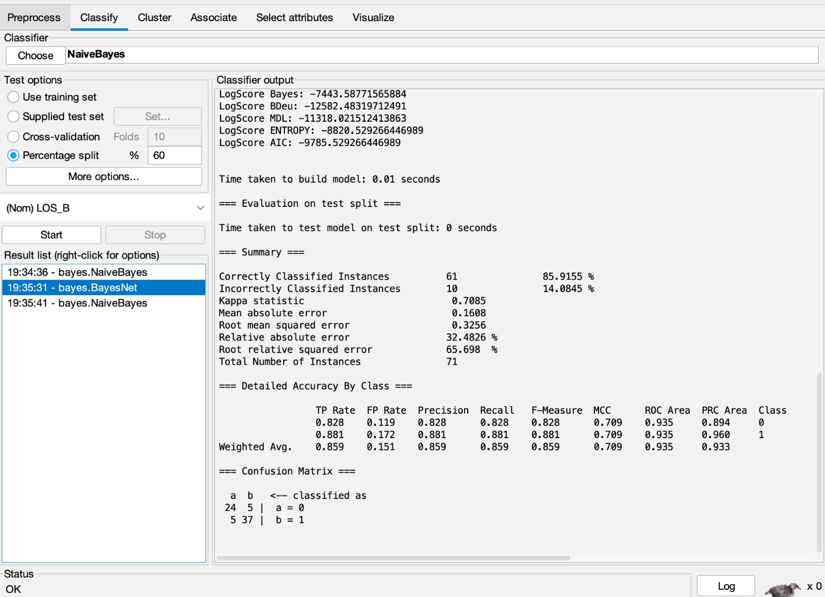
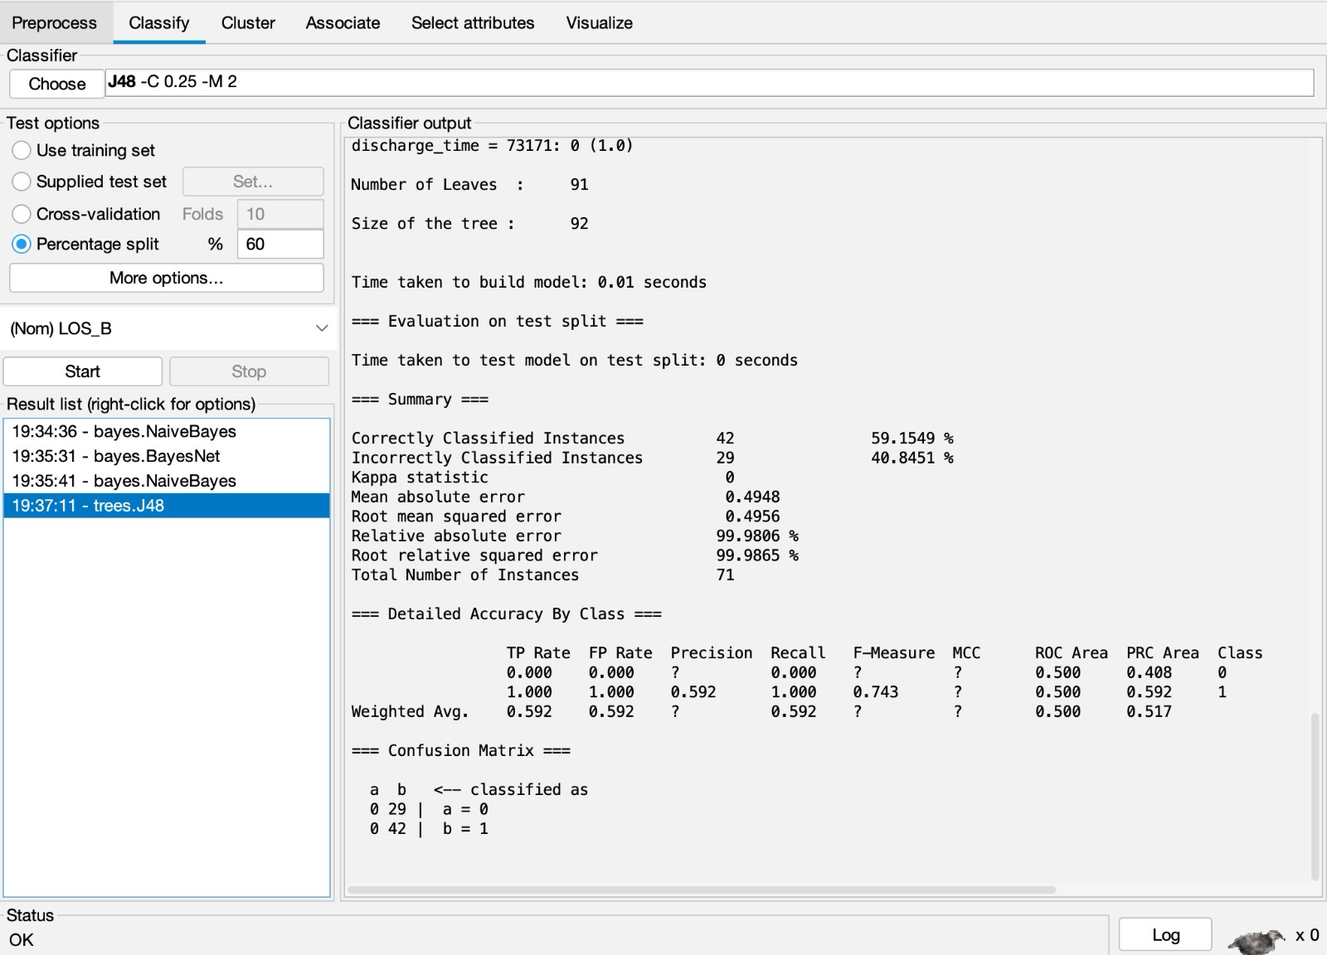
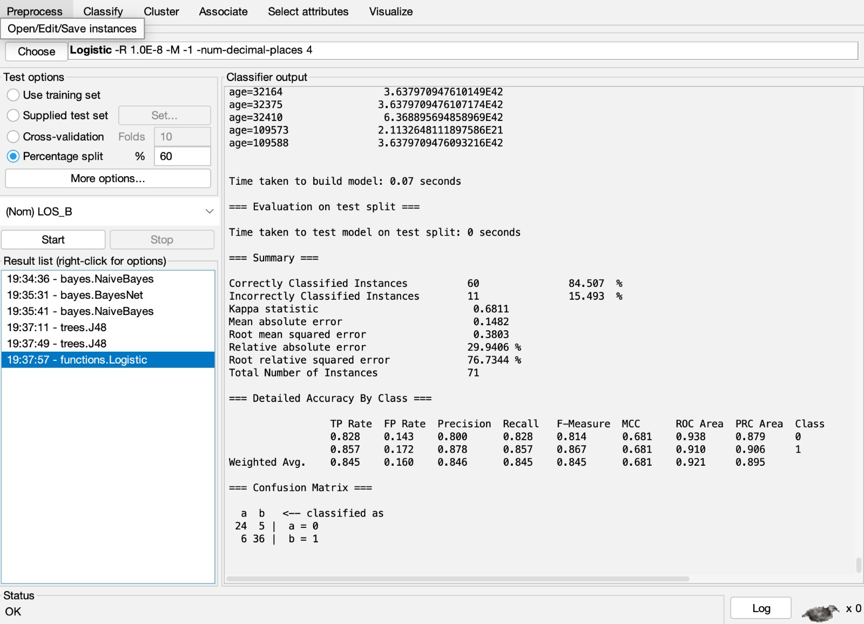
Machine Learning Method Data split 60%-40%
Naïve bayes
Bayes Net
Decision Tree
Logistic Regression

Slide 13
Cross Validation:
K-fold cross-validation involves dividing the dataset into 'k' equally-sized folds or subsets.
The model is trained 'k' times, each time using a different fold as the validation set and the remaining folds as the training set.
The final performance metric is computed by averaging the results from the 'k' training and validation iterations, providing a more robust assessment of the model's generalization performance.

Slide 14
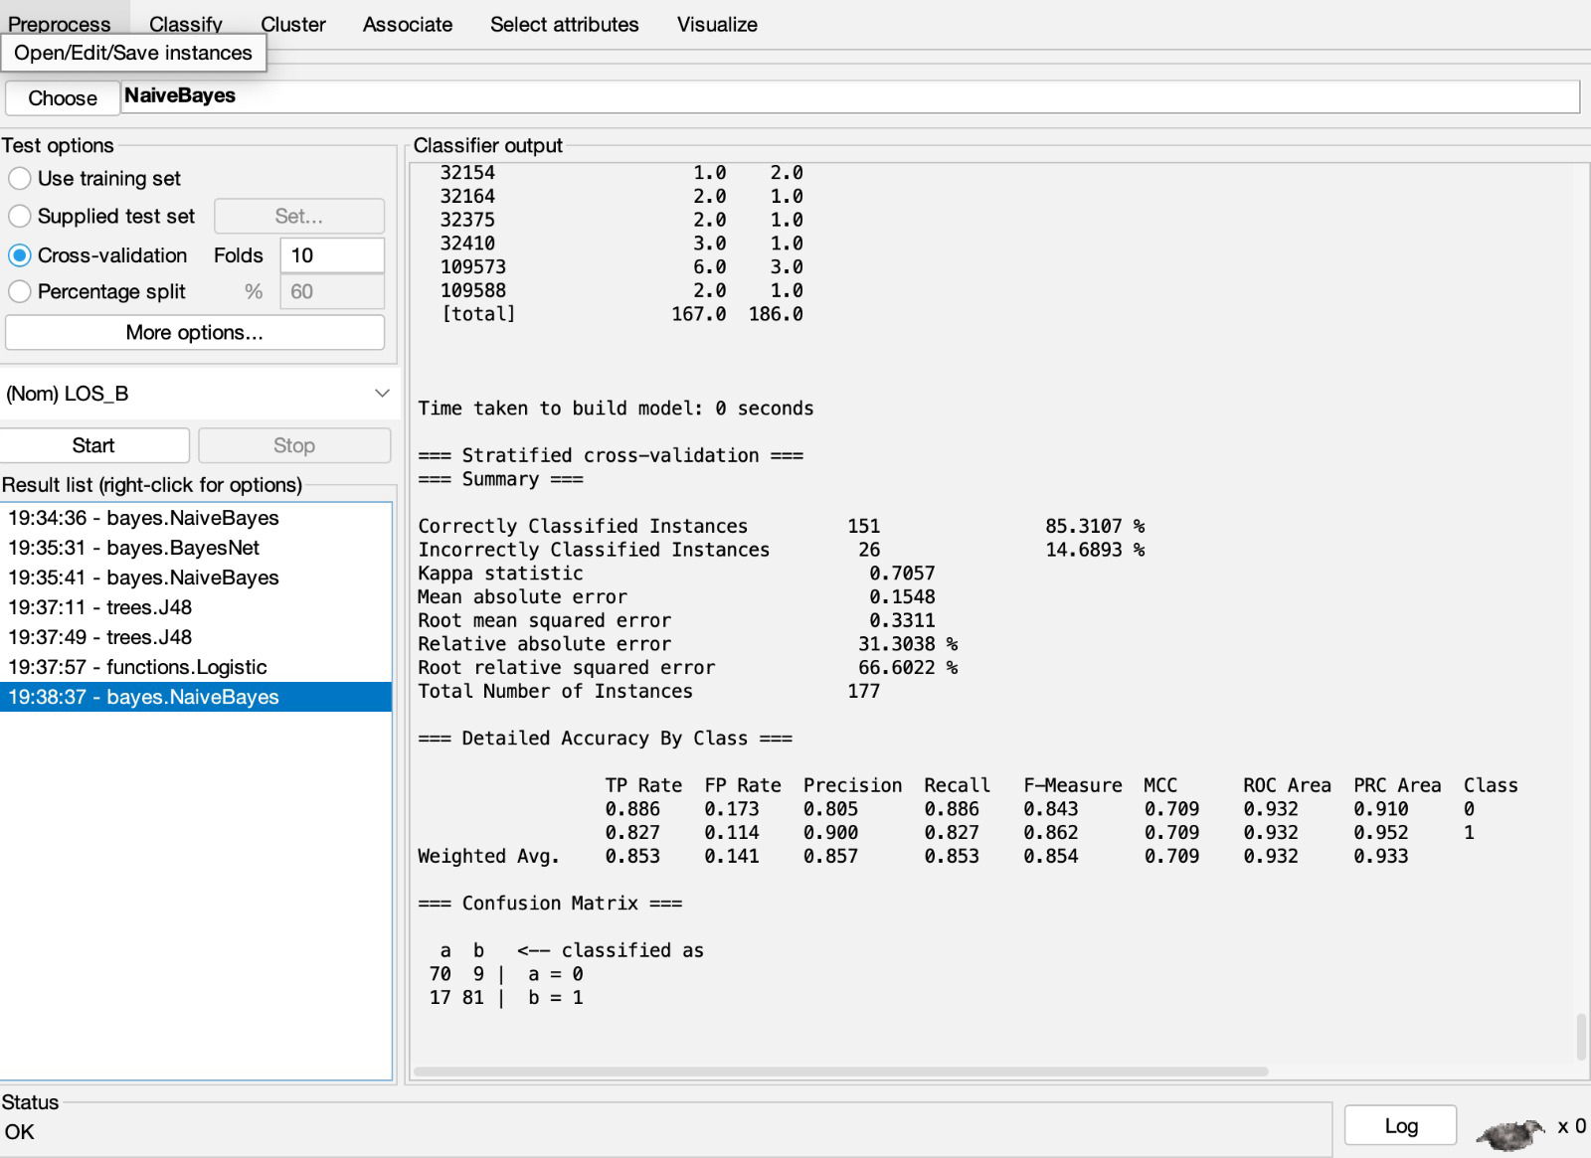
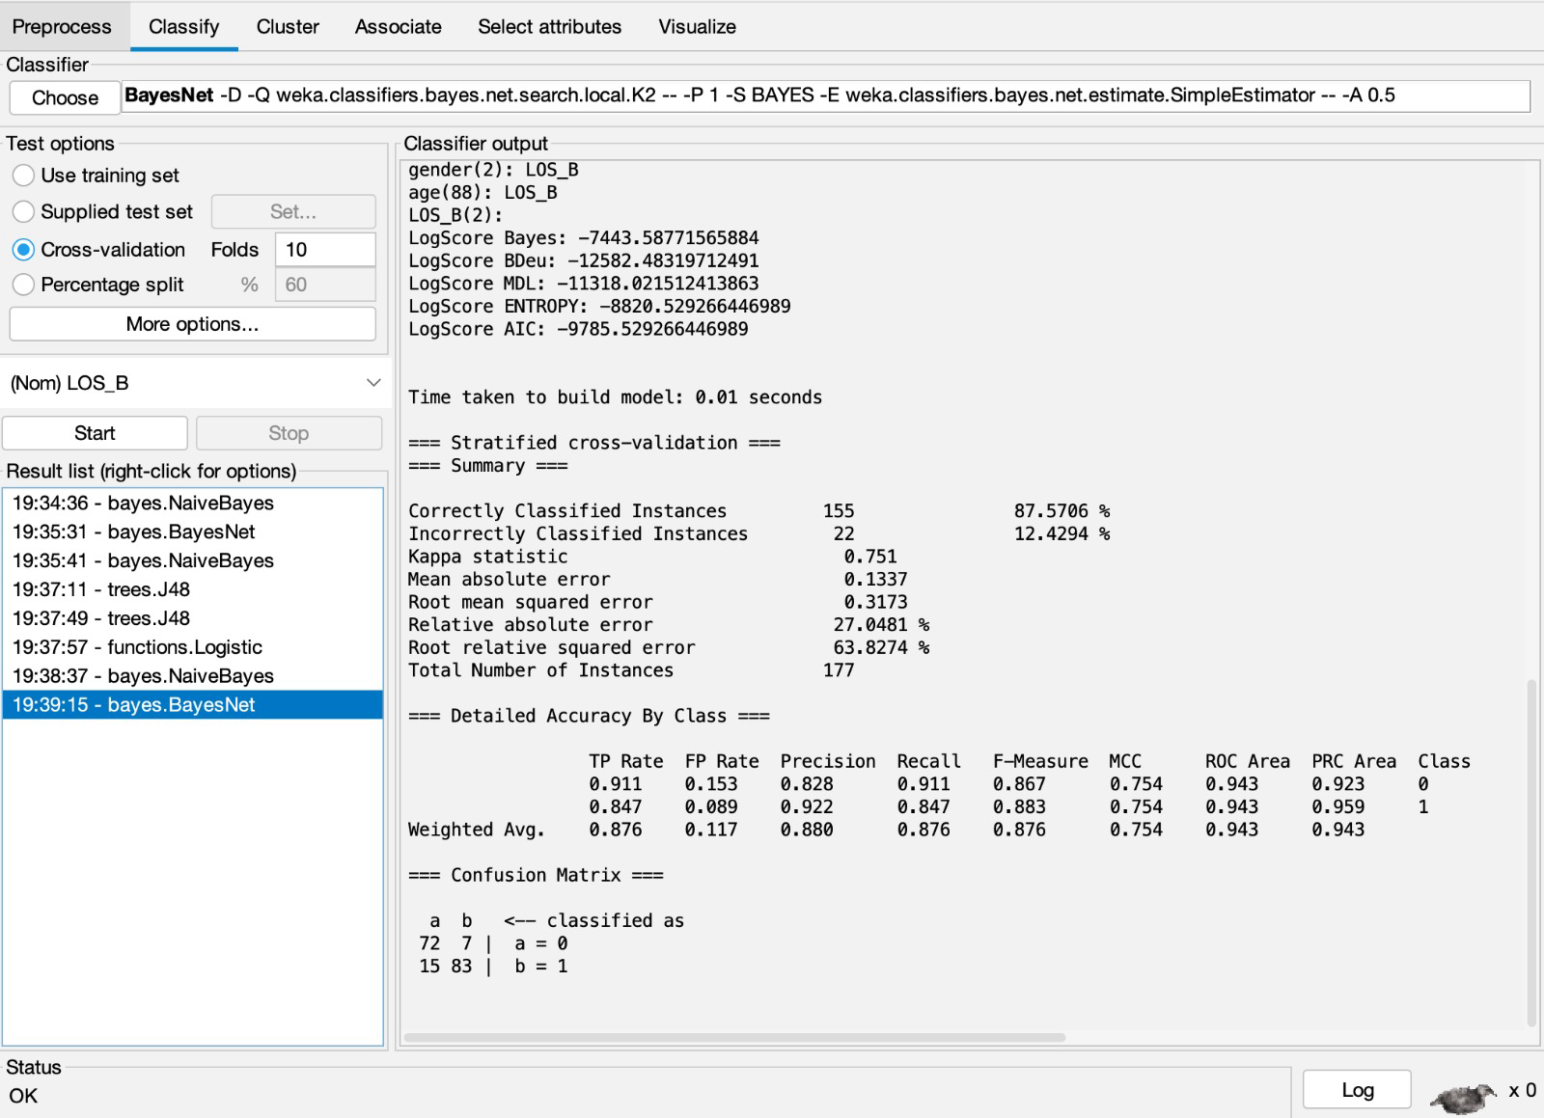
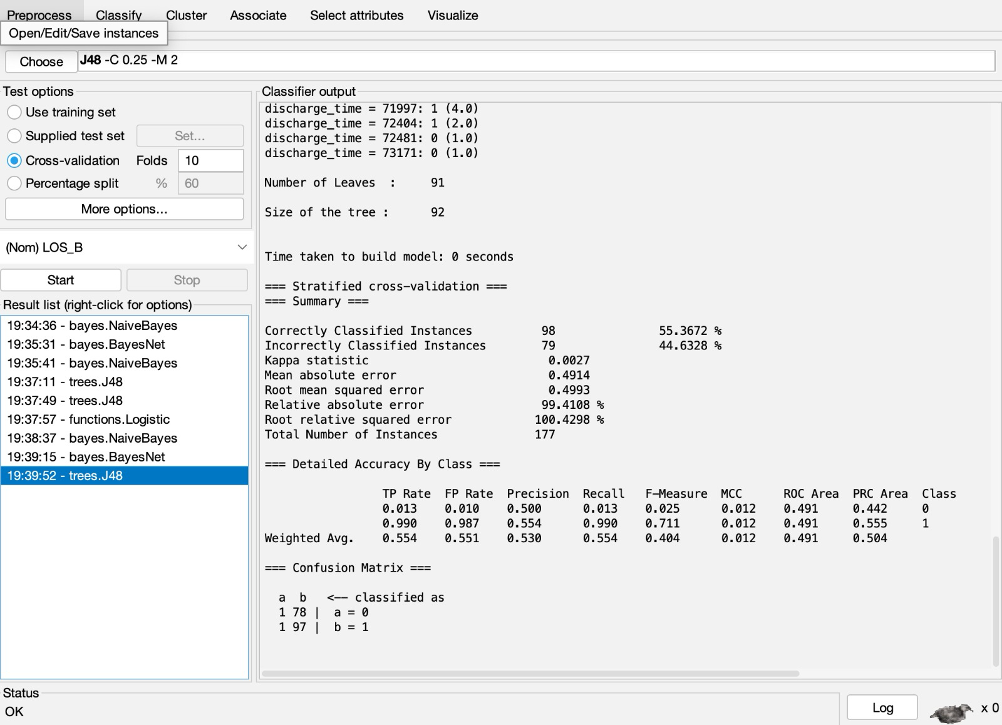
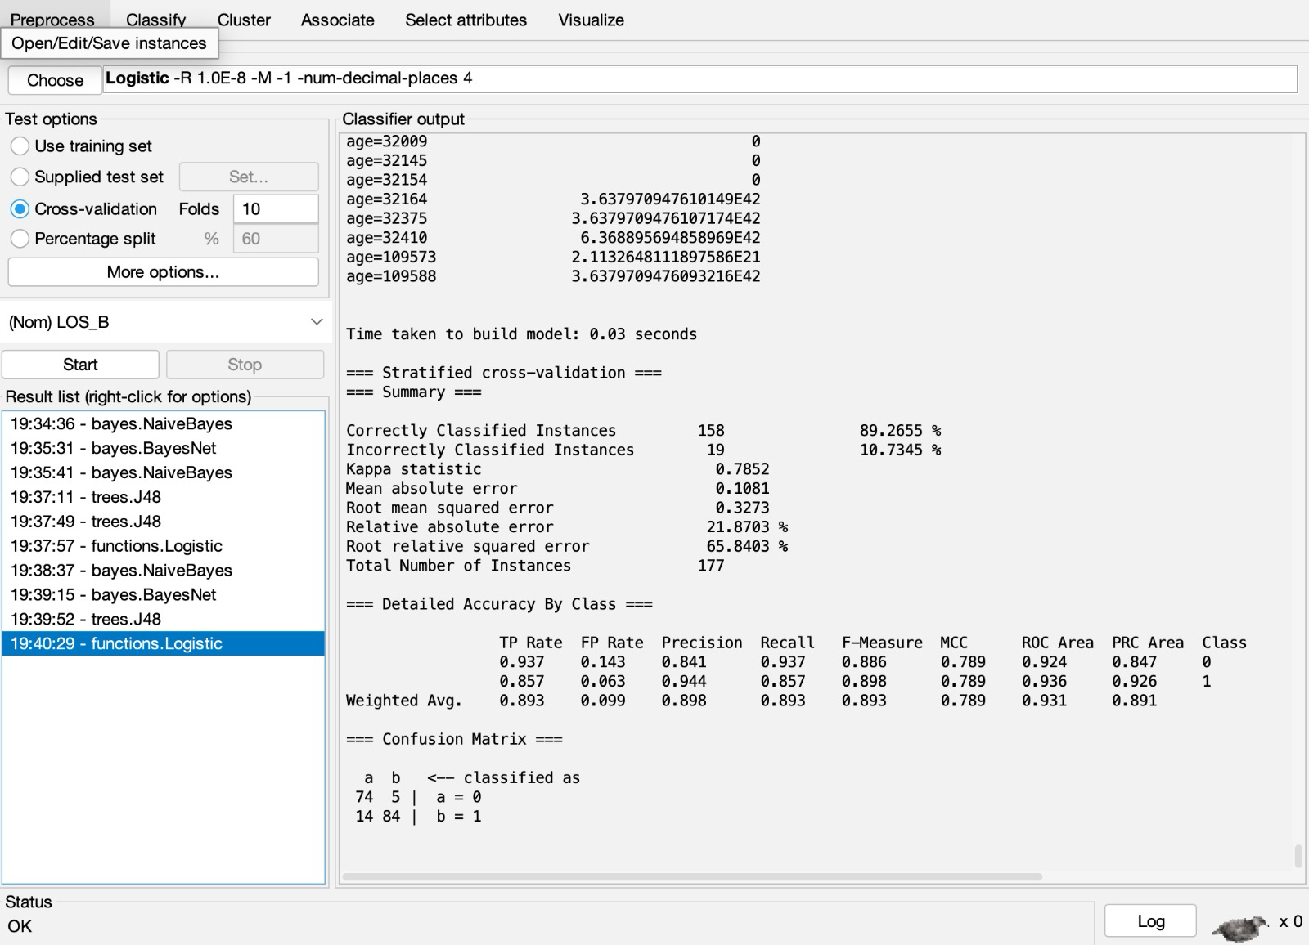
Cross Validation with 10 folds
Naïve bayes
Bayes Net
Decision Tree
Logistic Regression

Slide 15
Results:
Train Test Split
Cross Validation
When we compare the results of Conventional
Split data and 10-fold cross-validation we can see
The best results are achieved in the
cross-validation
Although the difference is not huge there
is a difference of some percent of overall change
in accuracy.
Accuracy | Recall
87.3% | 87.3%
85.9% | 85.9%
84.5% | 84.5%
59.1% | 59.2%
Accuracy | Recall
85.3% | 85.3%
87.5% | 87.6%
89.2% | 89.3%
55.3% | 55.4%
Naïve Bayes
Bayes Net
Logistic
Decision Tree

Slide 16
Conclusion:
Upon reviewing the performance metrics, it becomes evident that the Naïve Bayes Network model exhibits superior accuracy. However, a closer examination of the recall metric reveals that the logistic regression model outperforms the others.
Given the context of this project, where recall is of importance due to the potential consequences of resulting in false negatives, I would vote for the adoption of logistic regression.
In scenarios like these where the cost of a false negative is significant, such as in medical predictions, recall becomes a critical factor, potentially outweighing the overall accuracy in predicting the length of stay of patient greater than a week

Slide 17

Thank You

